Slide 1
Overfitting and Underfitting in machine learning
-Vaibhav Jumde
Under guidance of :
Dr. Ruby Jain mam & Prof. Kumar Sanjay Bhorekar sir

Slide 2
What is Overfitting?
Overfitting happens when a model learns the detail and noise in the training data to the extent that it negatively impacts the performance of the model on new data.
As a result, overfitting may fail to fit additional data, and this may affect the accuracy of predicting future observations.

Slide 3
What is Underfitting?
Underfitting occurs when a statistical model or machine learning algorithm cannot capture the underlying trend of the data.
Underfitting would occur, when fitting a linear model to non-linear data. Such a model too would have poor predictive performance.

Slide 4
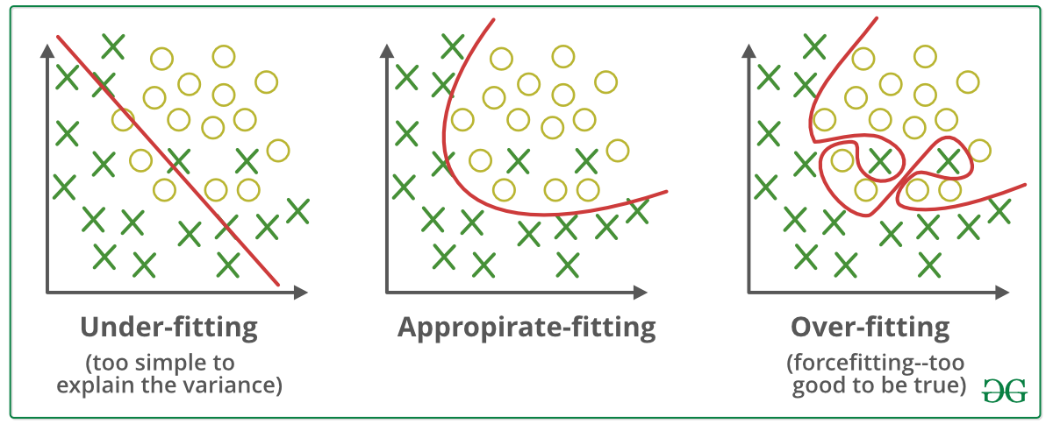
What is actual overfitting and underfitting happens?

Slide 5
Overfitting Underfitting
Learning too little of the true concept
Features don’t capture concept
Too much bias in model
Too little search to fit model
Fitting the data too well
Features are noisy / uncorrelated to concept
Modeling process very sensitive (powerful)
Too much search

Slide 6
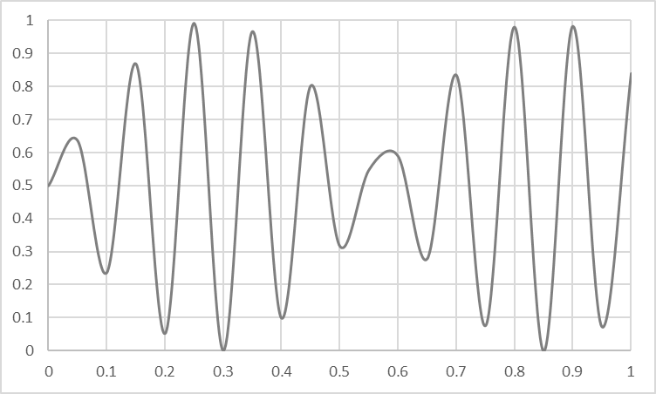
Overfitting Underfitting

Slide 7
Summary of Overfitting and Underfitting
Bias / Variance tradeoff a primary challenge in machine learning
Internalize: More powerful modeling is not always better
Learn to identify overfitting and underfitting
Tuning parameters & interpreting output correctly is key

Slide 8
Thank You!

